Slide 1
Visionscape .NET Training – Build Your Own App in Less Than 1 hour
Steven King

Slide 2
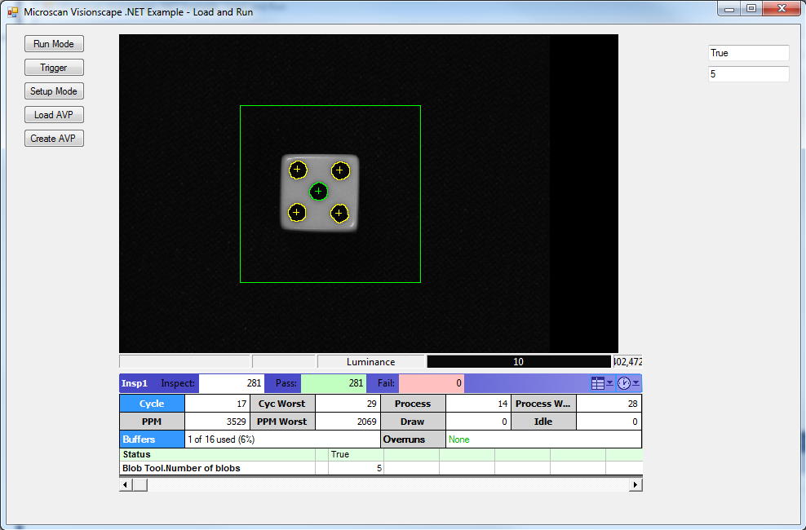
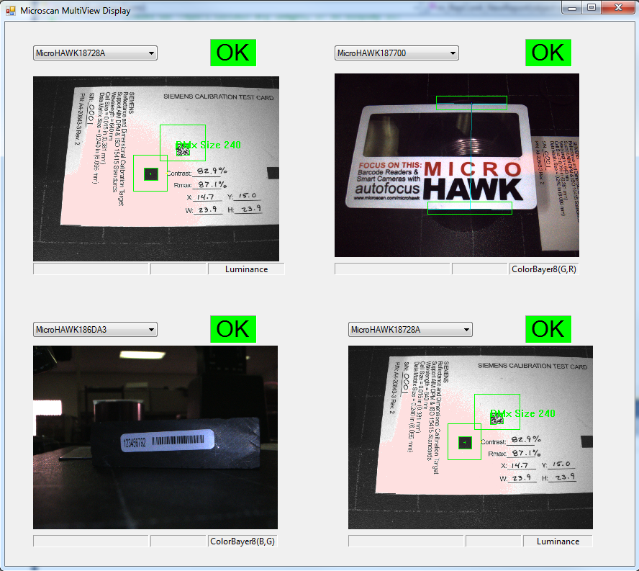
Visionscape .NET Controls - Custom User Interfaces, Fully Integrated Vision
Notes:
What the product is. Why is it significant. How to sell it.

Slide 3
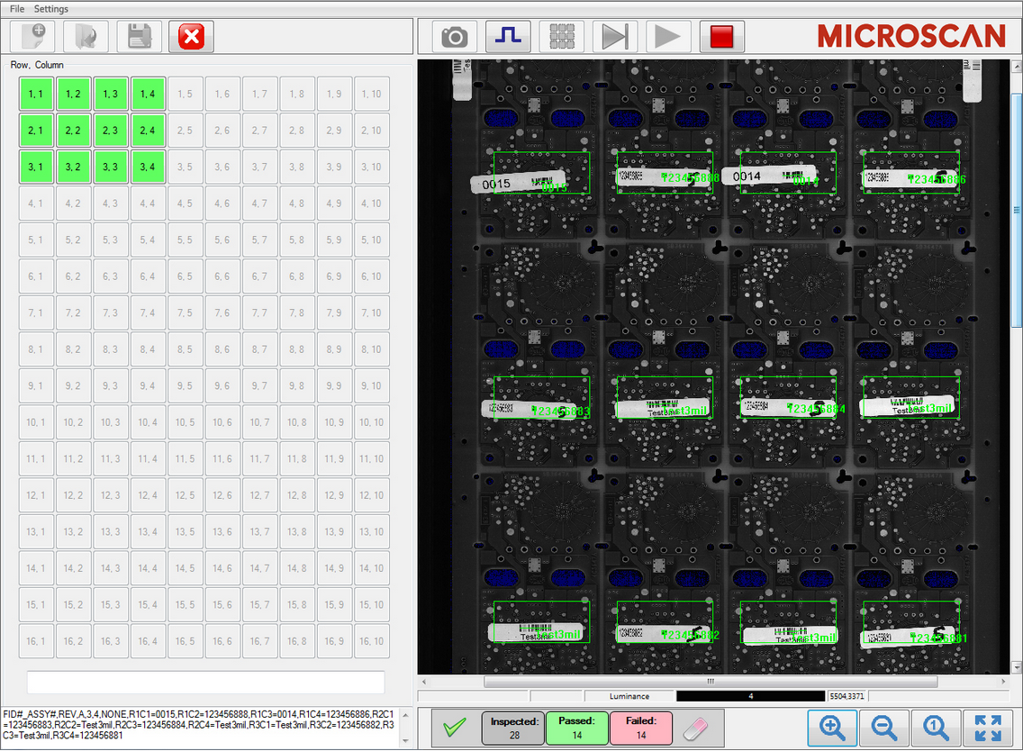
Visionscape .NET Controls - Benefits of Vision .NET Capability
Custom User Interfaces
Simple
Application Specific
Automatic Job Creation
Password Access Levels
Integrate Vision Directly with Automation
One UI to control entire machine
Tightly coupled Vision Results
Interactive Calibration
Access to all Microsoft .NET Capability
Data Base
Comm
Etc.
C:\Microscan\Vscape\Documentation\ Visionscape .NET Programmer’s Manual.pdf
Notes:
What the product is. Why is it significant. How to sell it.

Slide 4
Visionscape .NET Training – Topics
Interactively build a Load and Run Example
Load .AVP from Disk
Download .AVP to the camera
Run Mode
Get Reports from Camera. Data Display
Get Images from Camera. Image Display
Virtual Triggering
Setup Mode
Setup Manager View – Adjust and Test Job
Step Tree View – Manipulate Job in Step Tree View
Extra Features
Monitoring Multiple Cameras in Run Mode
Notes:
What the product is. Why is it significant. How to sell it.

Slide 5
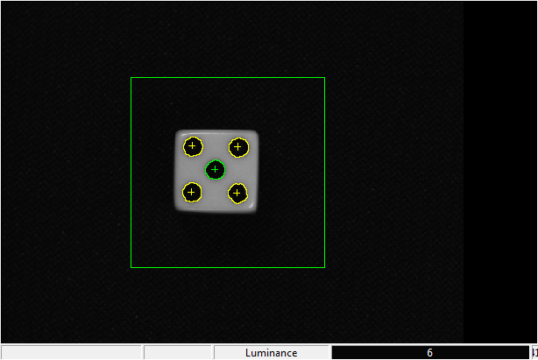
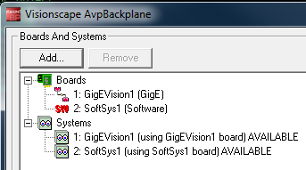
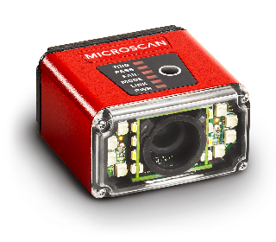
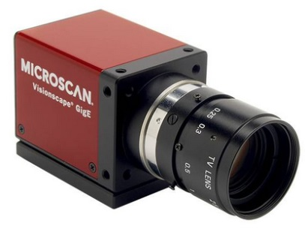
Visionscape .NET Training – Main Runtime Controls for Load and Run
PC
VsCoordinator – Finds and Allocates Control for all Vs Devices
ReportConnection
Retrieve Image
Retrieve Results
IOConnection
Triggering
AVP
Vision System Step
Inspection
Snapshot
Blob Tool
Formatted Output
JobStep
File Open
File Save
File New
VsDevice
Take Control
Download Job
Start
Stop
Notes:
What the product is. Why is it significant. How to sell it.

Slide 6
Visionscape .NET – Key Components for Handling Devices
VsCoordinator – AVP Backplane
Finds all vision devices on PC or on Network
Makes them available for use by single user
“Device Discovery”
VsDevice – Control The Vision Device (Emulator, GigE, Smart Camera)
Take Control
Download
Start
Stop
Notes:
What the product is. Why is it significant. How to sell it.

Slide 7
Visionscape .NET – Key Components Job Creation and Control
JobStep – File Manager
Allows you to open, save and create new AVP files
Step – Job Manipulation
Allows you to create Jobs programmatically
Add Steps programmatically
Get and Set Resource Datums (Parameters, ROI position, etc.)
Assign Results for Upload
Notes:
What the product is. Why is it significant. How to sell it.

Slide 8
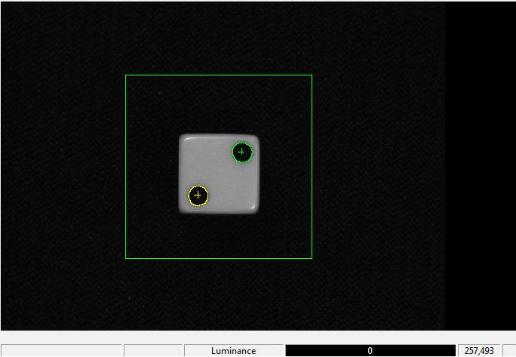
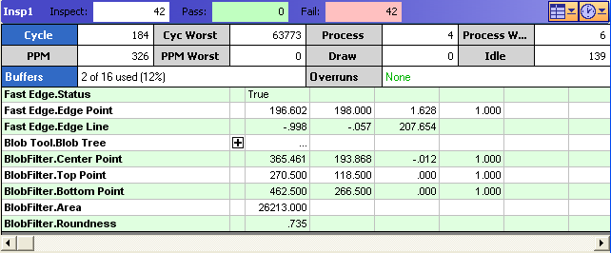
Visionscape .NET – Key Components for Run Mode
ReportConnection
Get Results from an Inspection on Device
BufferView
Display Images During Runtime
Multiple Buffer Views Allowed
ReportView, StatsView, ResultsView
Display Auto Formatted Results
ReportView combines Stats and Results
IO Connection
Get and Set IO on device
Trigger via Virtual IO
Notes:
What the product is. Why is it significant. How to sell it.

Slide 9
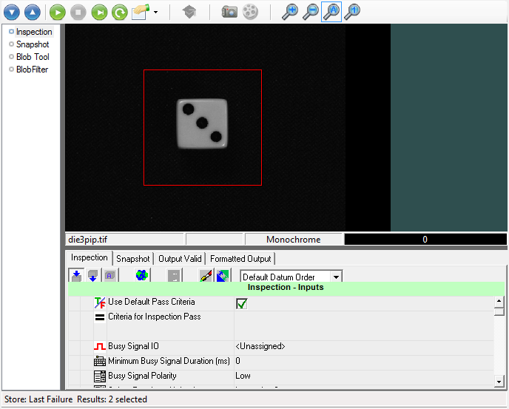
Visionscape .NET – Key Components for Setup Mode
Setup Manager
Job Editing
Job Tryout
Set RootStep to Inspection to connection
Set RootStep to Null to disconnect
Step Tree Editor
Job Tree Editing
Set RootStep to Inspection to connection
Set RootStep to Null to disconnect
Notes:
What the product is. Why is it significant. How to sell it.

Slide 10
Visionscape .NET Example – Create New Visual Studio Project
Launch Visual Studio 2010 (or Visual C# 2010 Express).
From the File Menu, choose “New Project…” (or “New Project…” from the Start Page.)
In the New Project dialog, choose “Visual C#” as your language, and then choose “Windows Forms Application” as your project template type.
Set to .Net Framework 4
Enter “CSharpExample” for the “Name”
Choose the “Location” for where you want to store your project
Press OK.
Notes:
What the product is. Why is it significant. How to sell it.

Slide 11
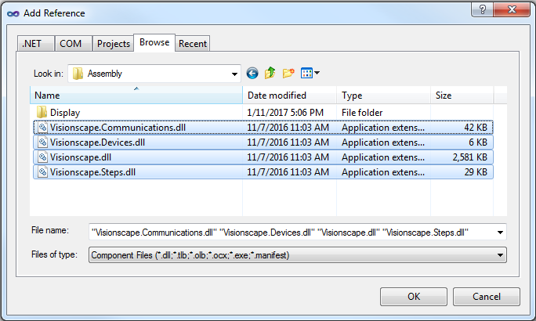
Visionscape .NET Example – Add References to Project
Go to the Project menu
Select “Add Reference”
Select “Browse” tab
Navigate to “C:\Microscan\Vscape\Assembly”
Select and Add References to the following Visionscape assemblies:
Visionscape.dll
Visionscape.Communications.dll
Visionscape.Devices.dll
Visionscape.Steps.dll
Click OK
Notes:
What the product is. Why is it significant. How to sell it.

Slide 12
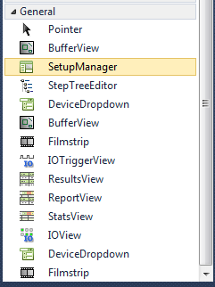
Visionscape .NET Example – Add “Display” Components to Project
Using Explorer, Navigate to “C:\Microscan\Vscape\Assembly”
Select the following :
Visionscape.Display.Devices.dll
Visionscape.Display.Reporting.dll
Visionscape.Display.Image.dll
Visionscape.Display.Setup.dll
Drag these to the General Tab in the Toolbox
You now have all the components we will use in this example
Notes:
What the product is. Why is it significant. How to sell it.

Slide 13
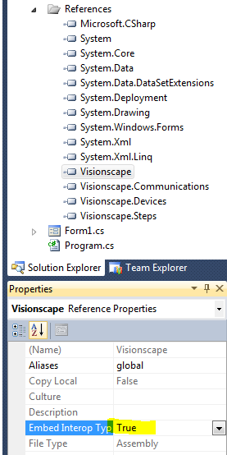
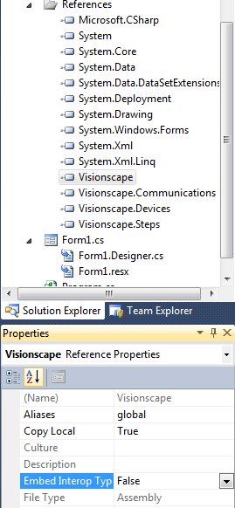
Visionscape .NET Example – Change Embed Interop Type
Under References
Select Visionscape
Change “Embed Interop Type” from True to False
This will change “Copy Local” from False to True. If not, do it explicitly.
Do the same thing for “stdole”
Notes:
What the product is. Why is it significant. How to sell it.

Slide 14
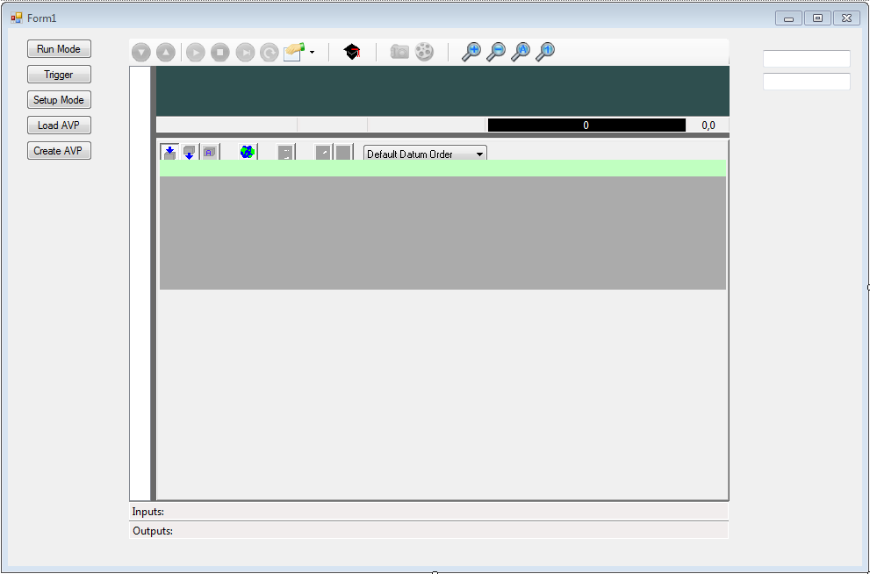
Visionscape .NET Example – Set Up Your Form
Make Form Bigger
Drag a “BufferView” onto form
Drag a “SetupManager” onto form
Add buttons for:
Run Mode
Trigger
Setup Mode
Load AVP
Create AVP
Add textBox1 and textBox2
Rename buttons appropriately, i.e.
btnRunMode, btnTrigger …
Notes:
What the product is. Why is it significant. How to sell it.

Slide 15
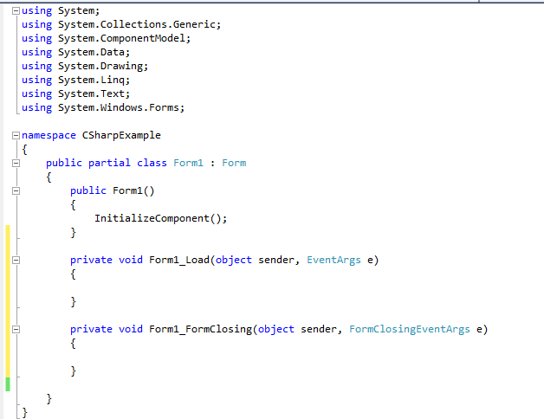
Visionscape .NET Example – Add Form Load and Form Closing Events
Click on the Main Form
Select Events in Properties
Double Click on Load
Double Click on FormClosing
You should now have this code
Notes:
What the product is. Why is it significant. How to sell it.

Slide 16
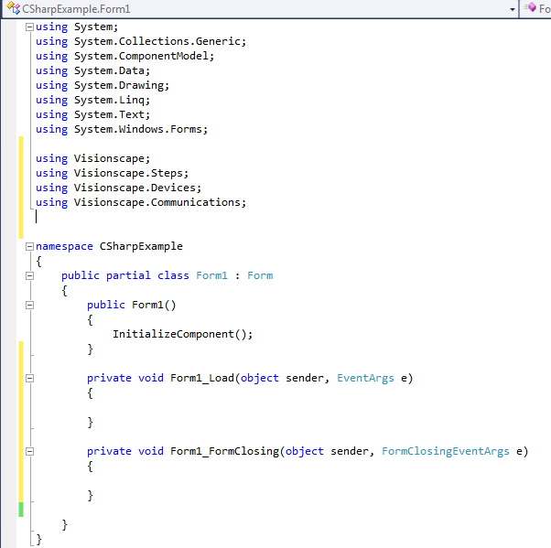
Visionscape .NET Example – Add “Using” for key references
Add the following snippet to the top of the form
using Visionscape;
using Visionscape.Steps;
using Visionscape.Devices;
using Visionscape.Communications;
Notes:
What the product is. Why is it significant. How to sell it.

Slide 17
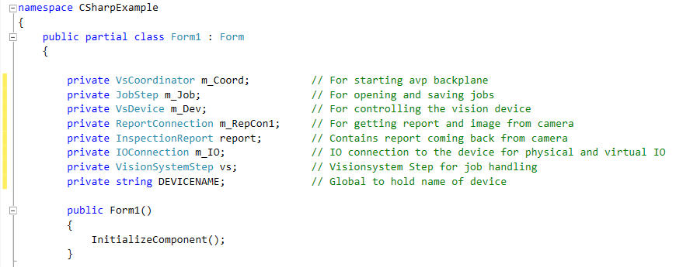
Visionscape .NET Example – Add key member variables
Add the following snippet to the partial class of the Form
private VsCoordinator m_Coord; // For starting avp backplane
private JobStep m_Job; // For opening and saving jobs
private VsDevice m_Dev; // For controlling the vision device
private ReportConnection m_RepCon1; // For getting report and image from camera
private InspectionReport report; // Contains report coming back from camera
private IOConnection m_IO; // IO connection to the device for physical and virtual IO
private VisionSystemStep vs; // Visionsystem Step for job handling
private string DEVICENAME; // Global to hold name of device
Notes:
What the product is. Why is it significant. How to sell it.

Slide 18
Visionscape .NET Example – Instantiate these objects (new)
Add the following snippet to Form_Load
// Show Buffer View, Hide Setup Manager
bufferView1.Show();
setupManager1.Hide();
// Instantiate all of our global objects
m_Coord = new VsCoordinator(); // Starts Backplane
m_Job = new JobStep();
m_RepCon1 = new ReportConnection();
m_IO = new IOConnection();
// Set DEVICENAME to your units name
DEVICENAME = "SoftSys1";
//DEVICENAME = "MicroHAWK187700";
Notes:
What the product is. Why is it significant. How to sell it.

Slide 19
Visionscape .NET Example – Set up event to discover device (camera)
Add the following snippet to Form_Load. This will connect to the device once it is found by m_Coord.
Hit TAB, TAB to complete the line
Finally add this line to have Coordinator alert the program when the device has been discovered.
You will see the following event code added
// Set up and event heandler to be called when AVP Backplane discovers my device
m_Coord.OnDeviceFocus +=
// Tell coordinator to fire the OnDeviceFocus event when the my DEVICENAME is discovered
m_Coord.DeviceFocusSetOnDiscovery(DEVICENAME, -1);
Notes:
What the product is. Why is it significant. How to sell it.

Slide 20
Visionscape .NET Example – Populate OnDeviceFocus Event Function
void m_Coord_OnDeviceFocus(VsDevice objDevice)
{
// Get handle to the Device
m_Dev = objDevice;
// Connect the IO control to the device. Only do this once.
m_IO.Connect(m_Dev);
// Create an event so that we see when IO on camera changes
// m_IO.IOTransition += new EventHandler<IOConnectionEventArgs>(m_IO_IOTransition);
// Initialize all IO to low, in this case Virtual 1
m_IO.PointWrite(VsIoType.Virtual, 0, false);
// Load our job from disk
m_Job.Load("C:\\Microscan\\Vscape\\Jobs\\test.avp");
// Get the first VisionSystemStep in the job
vs = m_Job.VisionSystemStep();
// Connect the VisionSystemStep to our device
vs.SelectSystem(m_Dev.Name);
//Now we can download to the device(vision system) and run the job on that device
m_Dev.Download(vs, true);
// Connect reports to the inspection on the device
m_RepCon1.Connect(DEVICENAME, 1, ReportConnection.ConnectOptions.DEFAULT);
// Make images part of the report
m_RepCon1.AddSnapBuffers((Visionscape.Steps.InspectionStep)m_Job.FindBySymName("Insp1"));
// Now start the device
m_Dev.StartAll();
}
Optional if you want to see IO transitions from the camera.
Type in first part of line, +=, and the Tab Tab to autocomplete the line, and add the events.
Notes:
What the product is. Why is it significant. How to sell it.

Slide 21
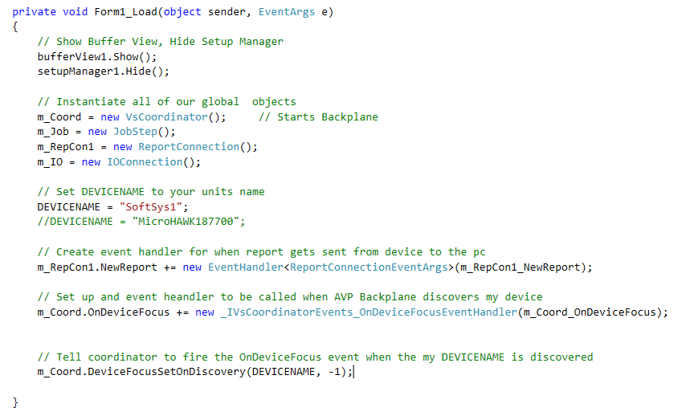
Visionscape .NET Example – Set up event to get reports
Add the following snippet to Form_Load. This will create a Report Event that gets called when a new report is uploaded.
FormLoad now looks like this
// Create event handler for when report gets sent from device to the pc
m_RepCon1.NewReport +=
Notes:
What the product is. Why is it significant. How to sell it.

Slide 22
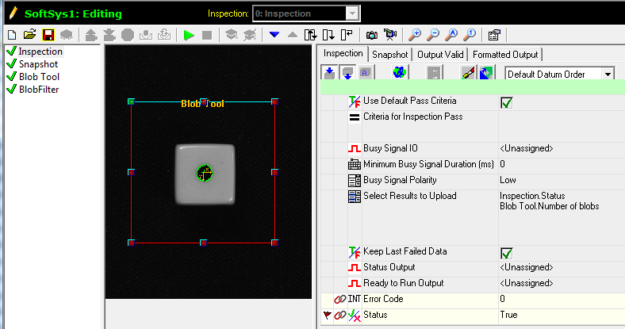
Visionscape .NET Controls – Create a Test Job
Simple Blob Job
Count Dark Parts
Ignore Blobs That Touch ROI
Set for Results Upload
Inspection Status
Number of Blobs
Save Job
“c:\vscape\jobs\test.avp”
Notes:
What the product is. Why is it significant. How to sell it.

Slide 23
Visionscape .NET Example – Populate NewReport Event Function
void m_RepCon1_NewReport(object sender, ReportConnectionEventArgs e)
{
// Get the Inspection report
report = e.Report;
// Get Number of Blobs
bool status;
long numBlobs;
status = report.Results[0].AsBool;
textBox1.Text = status.ToString();
numBlobs = report.Results[1].AsInt;
textBox2.Text = numBlobs.ToString();
//does our report contain any images, if so display it?
if (report.Images.Count > 0)
{
//extract the image as a BufferDm,
//and set it into the Buffer View
bufferView1.Buffer = (BufferDm)report.Images[0];
}
// This is a good place to collect unused memory
GC.Collect();
}
This gets the first and second result datums. Types must be matched.
Set image into BufferView if image count > 0
Always, always include this line or you can get memory drain
Notes:
What the product is. Why is it significant. How to sell it.

Slide 24
Visionscape .NET Example – Unwind all controls during shutdown
private void Form1_FormClosing(object sender, FormClosingEventArgs e)
{
// Stop all inspections
if (m_Dev != null)
m_Dev.StopAll();
// Disconnect the reports
if (m_RepCon1 != null)
m_RepCon1.Disconnect();
m_RepCon1 = null;
// Disconnect the IO
if (m_IO != null)
m_IO.Disconnect();
m_IO = null;
// Disconnect from the camera
if (m_Dev != null)
m_Dev.Disconnect();
m_Dev = null;
// Set the RootStep of setup manager to null
setupManager1.RootStep = null;
// Clear the job from pc memory
while (m_Job.Count > 0)
m_Job.Remove(1);
m_Job = null;
}
Notes:
What the product is. Why is it significant. How to sell it.

Slide 25
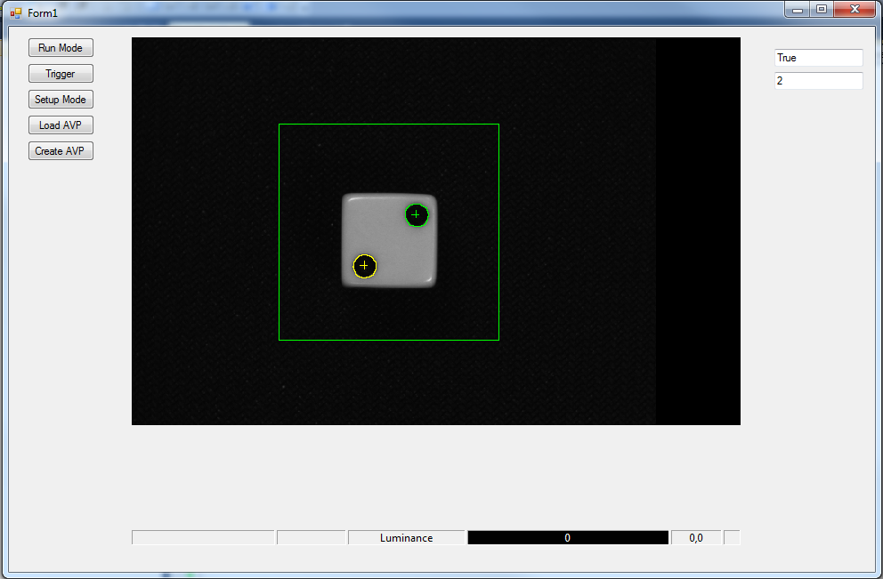
Visionscape .NET Example – Run the example
Job will load and run
It will show images and data
Buttons not functional yet
Stop by closing form
Notes:
What the product is. Why is it significant. How to sell it.

Slide 26
Visionscape .NET Example – Run Mode Button
private void btnRunMode_Click(object sender, EventArgs e)
{
// Show Buffer View
bufferView1.Show();
// Hide Setup Manager
setupManager1.Hide();
setupManager1.RootStep = null;
// Download Job to Device
m_Dev.Download(m_Job, true);
// Connect reports to the inspection on the device
m_RepCon1.Connect(DEVICENAME, 1, ReportConnection.ConnectOptions.DEFAULT);
// Make images part of the report
m_RepCon1.AddSnapBuffers((Visionscape.Steps.InspectionStep)m_Job.FindBySymName("Insp1"));
// Now start the device
m_Dev.StartAll();
}
Notes:
What the product is. Why is it significant. How to sell it.

Slide 27
Visionscape .NET Example – Setup Mode Button
private void btnSetupMode_Click(object sender, EventArgs e)
{
// Stop the device and disconnect reports
m_Dev.StopAll();
m_RepCon1.Disconnect();
// Show setupManager1 starting with Inspection as first step
setupManager1.ListViewSize = 80;
setupManager1.ImageViewSize = 300;
setupManager1.ZoomAuto();
setupManager1.RootStep = (Visionscape.Steps.Step)m_Job.FindBySymName("Insp1");
setupManager1.Show();
// Hide Run View
bufferView1.Hide();
}
Choose what is displayed as part of these controls
Example : setupManager1.OptionLayoutSet(Visionscape.Display.Setup.SetupManagerLayoutOptions.ShowToolbar,false);
Turns off Toolbar so you can create your own buttons for Acquire, Live, Tryout etc.
Notes:
What the product is. Why is it significant. How to sell it.

Slide 28
Visionscape .NET Example – Trigger Button
private void btnTrigger_Click(object sender, EventArgs e)
{
// Set IO to low, in this case Virtual 1
m_IO.PointWrite(VsIoType.Virtual, 0, false);
// Put in short delay
System.Threading.Thread.Sleep(5);
//Set IO to high, in this case Virtual 1
m_IO.PointWrite(VsIoType.Virtual, 0, true);
}
Go To Setup Mode
Change Trigger Virtual 1
Go To Run Mode
Tryout Trigger
Notes:
What the product is. Why is it significant. How to sell it.

Slide 29
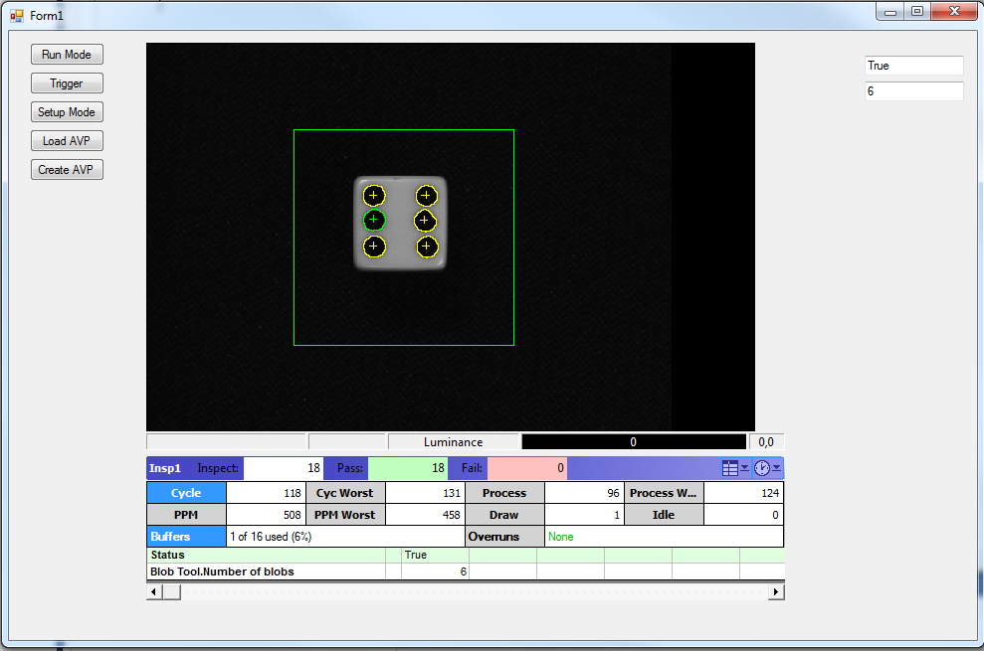
Visionscape .NET Example – Extra Credit – Add Report View
ReportView
Add ReportView to Form
Hook in NewReport
// Get the Inspection report
report = e.Report;
// Dump results to report view
reportView1.Report = report;
Notes:
What the product is. Why is it significant. How to sell it.

Slide 30
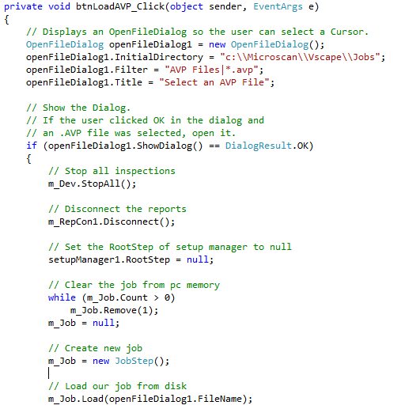
Visionscape .NET Example – Extra Credit – Open AVP From File
Open AVP from File
See btnLoadAVP_Click
Notes:
What the product is. Why is it significant. How to sell it.

Slide 31
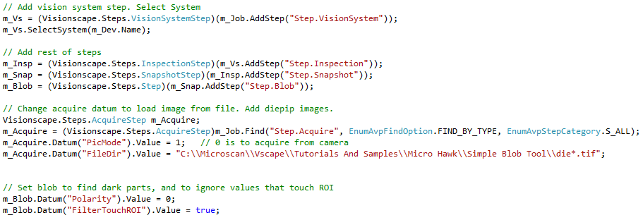
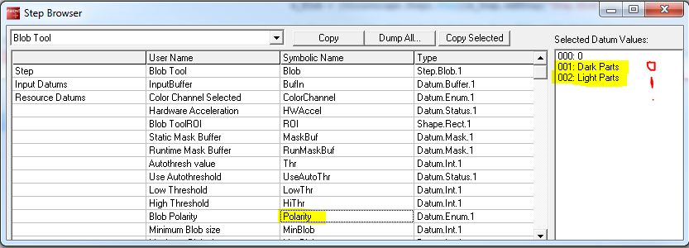
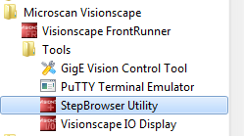
Visionscape .NET Example – Extra Credit – Auto Create an AVP
Programmatically Create AVP
See btnCreateAVP_Click
Use StepBrowser
Input Datums
Resource Datums
Output Datums
Notes:
What the product is. Why is it significant. How to sell it.

Slide 32
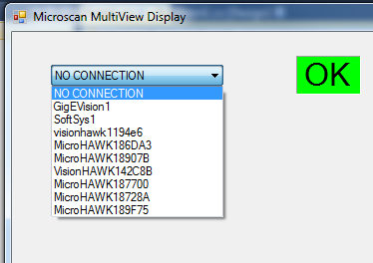
Multiview Display Example
Example using Device Dropdown
Notes:
What the product is. Why is it significant. How to sell it.

Slide 33
Microscan Advanced Programming Capabilities
Visionscape .NET Programming
Requires Visionscape to be loaded onto the PC
Rest APIs/Serial Command Set
Visionscape does not need to be installed
WEB SDK
For MicroHAWK ID - http://www.microscan.com/en-us/support/download-center
Notes:
What the product is. Why is it significant. How to sell it.

Slide 34
Wrap Up
A follow up email will be sent to you. Please respond with comments or questions.
sking@microscan.com
visionsupport@microscan.com
A link to the presentation and example programs will be in the email.
Thank you very much, and Good Programming!
Notes:
What the product is. Why is it significant. How to sell it.

Slide 35
Visionscape .NET Training – Build Your Own App in Less Than 1 hour
Steven King
Sking@microscan.com

